Slide 1
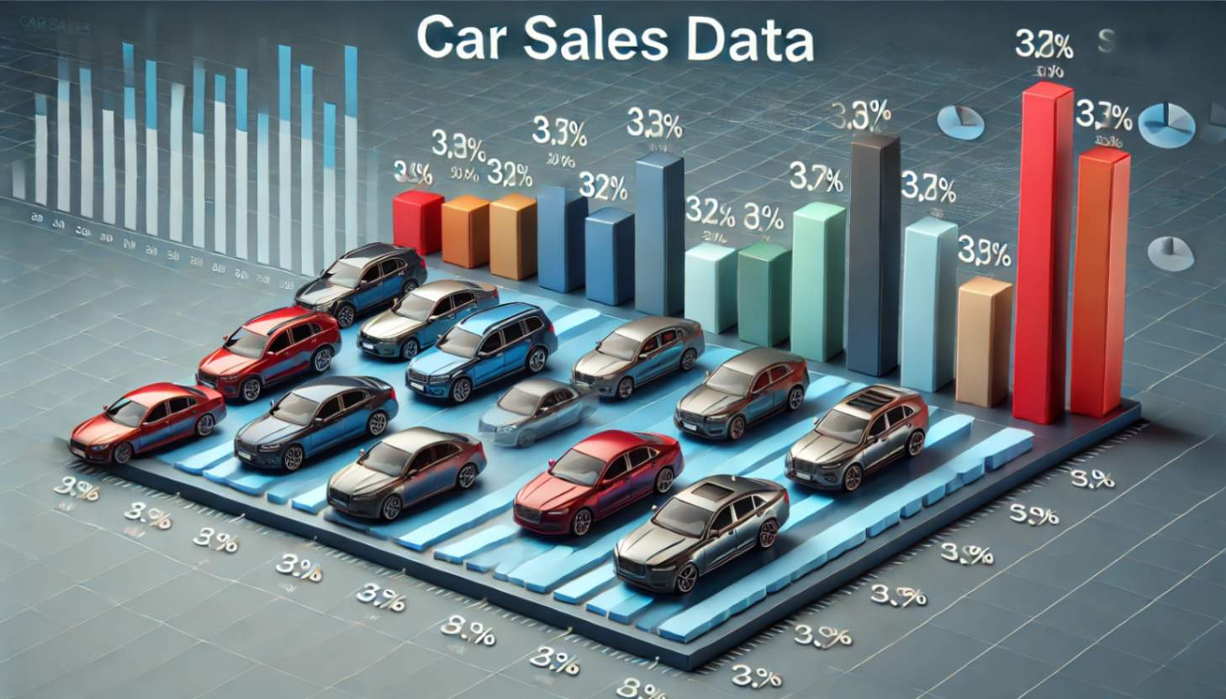
Statistical Assessment for Data Analyst
CAR ASSIGNMENT
Import Libraries
2. Load Dataset Objective: Import the dataset for analysis. Use pd.read_csv() for loading datasets from CSV. Replace the placeholder path with your dataset location.
Loading necessary libraries for data processing and visualization is the goal. Data manipulation with Pandas and NumPy Seaborn, Matplotlib: Static visuals Plotly: Visualizations that interact

Slide 2
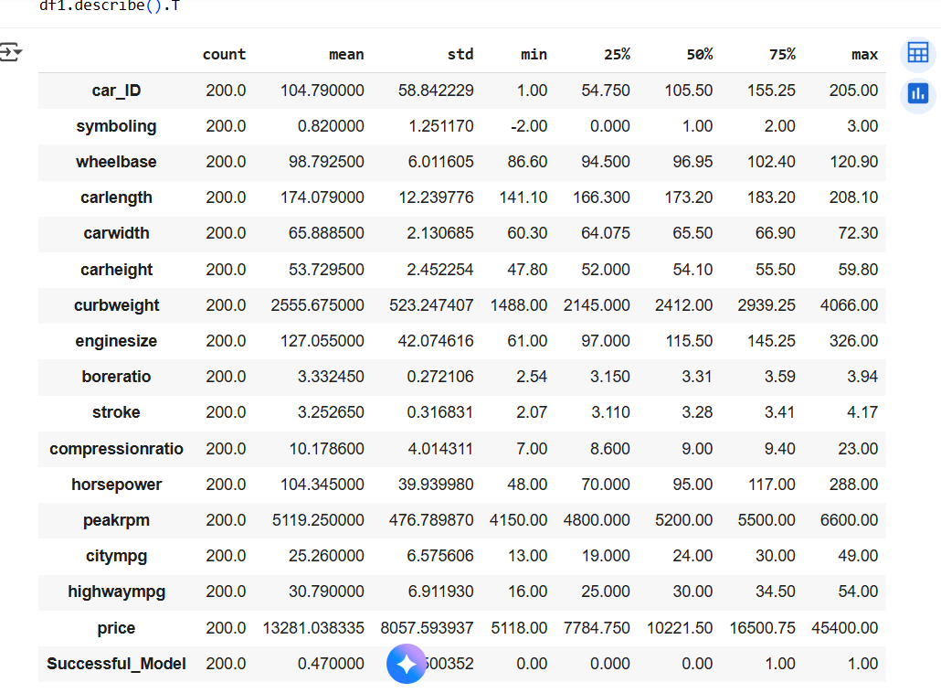
3. Understanding the Dataset
Objective: To obtain a high-level understanding of the dataset. Shape of dataset: Rows and columns count. Data Types: To identify numerical and categorical columns. Missing Values: Identify and count missing values. Summary Statistics: Descriptive statistics (mean, std, min, max) for numerical features and frequency for categorical features.

Slide 3
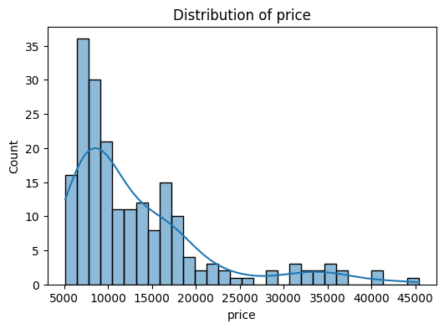
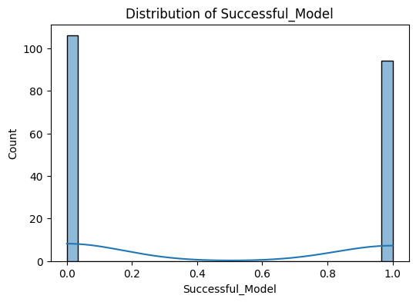
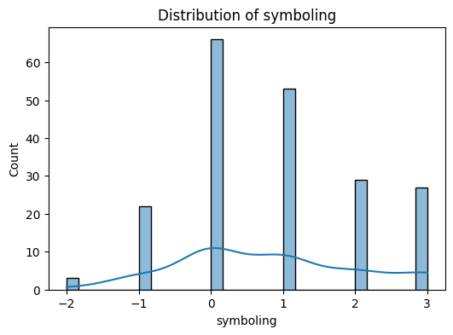
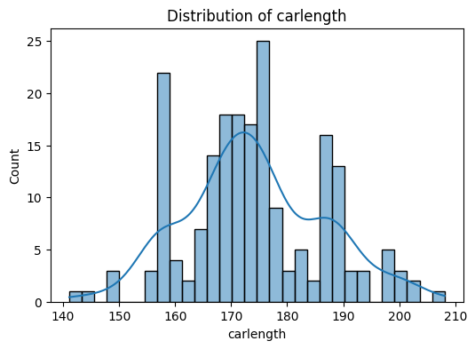
4. Univariate Analysis Objective: To analyze individual features. Numerical Features: To visualize distributions using histograms and KDE plots, check skewness and normality. Categorical Features: Visualizing frequencies using count plots.

Slide 4
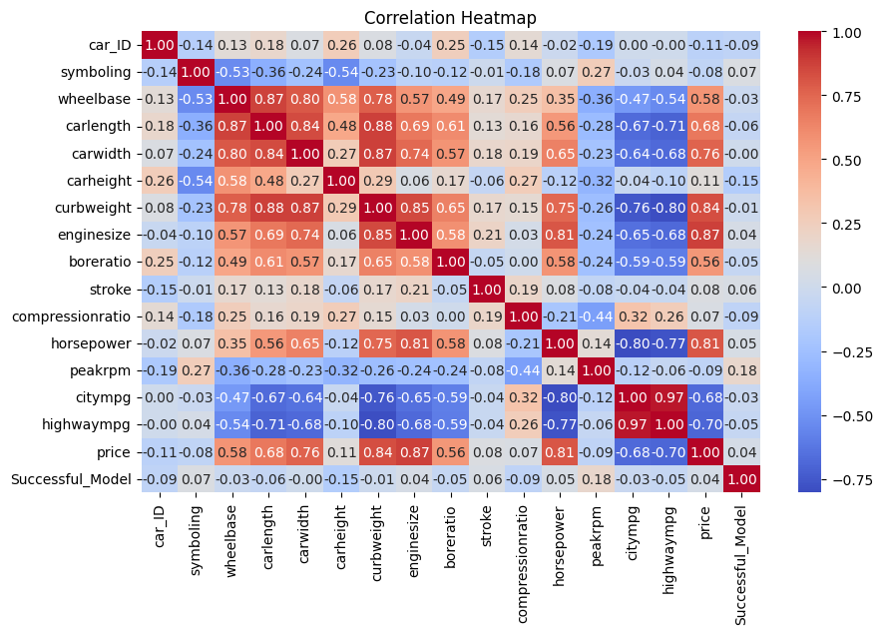
5. Bivariate Analysis Objective: Understand relationships between variables. Correlation Heatmap: Shows relationships between numerical variables. Identify strong correlations (positive/negative).
6. Outlier Detection Objective: Identify potential outliers in numerical features.
Actionable Insights: Decide on handling strategies like removing or capping outliers.

Slide 5
7. Data Visualization
Missing information can be used to visualize missing data patterns.
Identifies rows or columns with a significant amount of missing data.
The process of feature engineering Regarding date characteristics or time series:
Extra features such as the day, weekday, month, and so on should be extracted for analysis.
Encoding categorical variables is necessary when preparing data for machine learning.
The challenge will determine whether to use label encoding or one-hot encoding.
8. Data Cleaning: Addresses missing values by removing or imputation. Responds to outliers according to how they affect the model's performance.

Slide 6
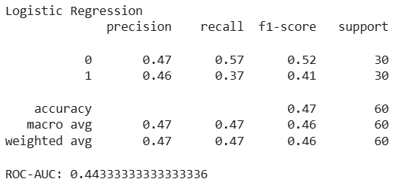
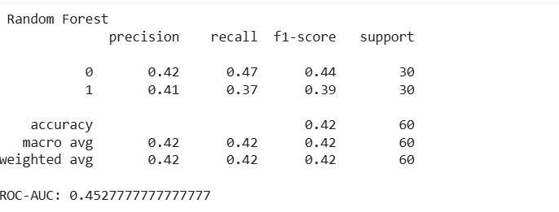
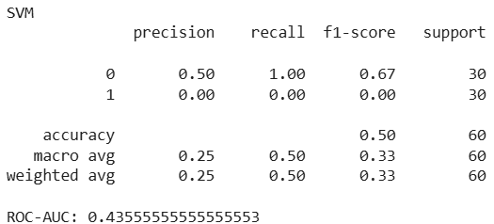
9. Engineering Features: It provides machine learning models with useful properties.
10. Modeling Prepare features for machine learning algorithms by utilizing EDA insights.
Three models were developed namely Logistic regression, Random forest Support vector machine.
Logistic Regression shows the overall accuracy is 0.47 states that fewer than half predictions are correct and ROC-AUC is 0.44 indicating weak separation between classes.
Random forest shows 0.45 ROC-AUC reflecting limited predictive performance.
SVM comes with 0.50 accuracy indicating many correct predictions from one class and ROC-AUC is 0.67 which is higher than other models but likely biased due to class imbalance.

Slide 7
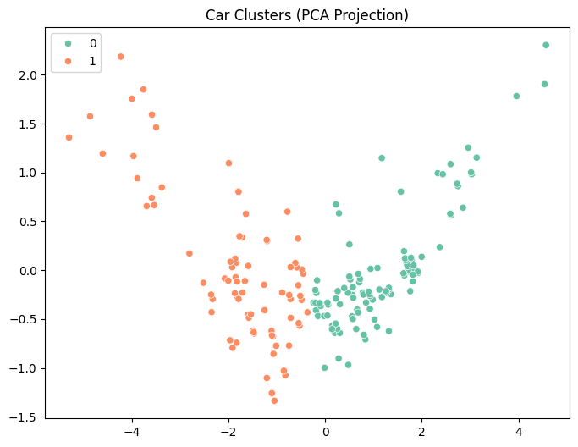

11. Clustering
The below cluster plot shows car data condensed using Principal Component Analysis(PCA) with each point representing a car and clolor based on cluster membership. There are two clusters 0(green) and 1(orange) in car dataset suggests distinct grouping based on underlying features are reduced to two principal components.
Cluster 0 consists of cars with low average horsepower(80.33), lower price(8548.32),higher citympg (29.31) and higher highwaympg (35.08)
Cluster 1 contains cars with higher average horsepower (140.36), higher price (20380.11),lower citympg(19.19) and lower highwaympg (24.35).
0 - economical, lower powered vehicles
1 higher priced, high performance cars that are less fuel - efficient

Slide 8
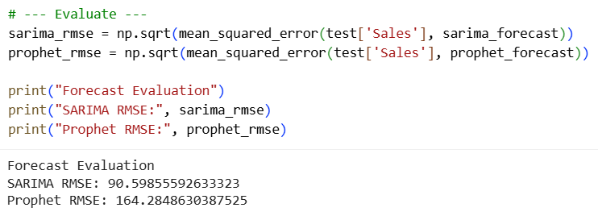
1. The dataset includes date-aggregated car sales data that has been weekly resampled in order to have it ready for time series analysis. 2. The latest 12 weeks of sales data are set aside for validation while training two forecasting models, SARIMA and Prophet. 3. SARIMA forecasts are produced using the seasonal autoregressive integrated moving average; however, a warning that there is insufficient data may impact parameter estimate is included. 4. Prophet, a business time series forecasting model, is fitted and used to anticipate weekly sales in the future. By default, it disables certain seasonalities. 5. SARIMA performs better on this automobile sales dataset by producing a smaller error (~90.6) than Prophet (~164.3), according to evaluation using root mean squared error (RMSE).

Slide 9
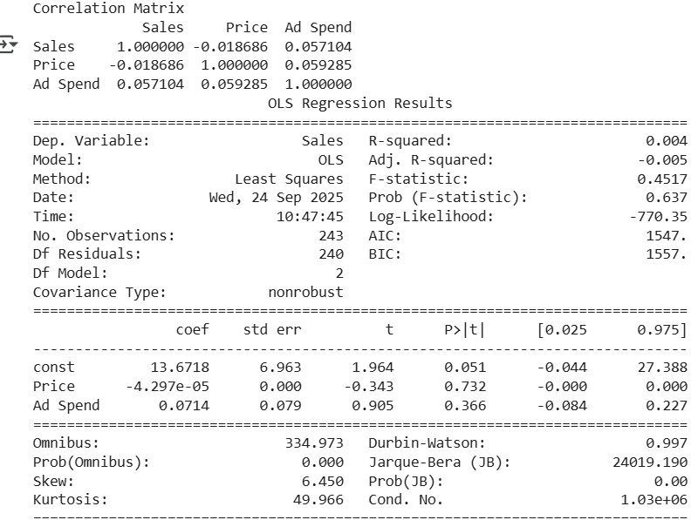
Conclusion
The correlation matrix shows very weak correlations between Sales, Price, and Ad Spend, indicating minimal linear relationships.
Multiple linear regression was performed with Sales as the dependent variable and Price and Ad Spend as independent variables.
The regression model's R-squared is extremely low (0.004), showing that Price and Ad Spend explain almost none of the variability in Sales.
The coefficients for Price and Ad Spend are not statistically significant, with high p-values that suggest these predictors do not reliably influence Sales in this dataset.
The model diagnostics warn of potential multicollinearity or numerical issues, which may affect the regression analysis results.
Relation between Price, Ad spend and sales

